Slide 1
Performance Analysis of Parallel Support Vector Machines on a MapReduce Architecture
Udita Patel
Department of Computer Science

Slide 2
Agenda
Introduction
Support Vector Machines
Data Preprocessing
MapReduce Programming Model
Parallel Algorithms
Results
Conclusions
Future Works
Acknowledgement

Slide 3
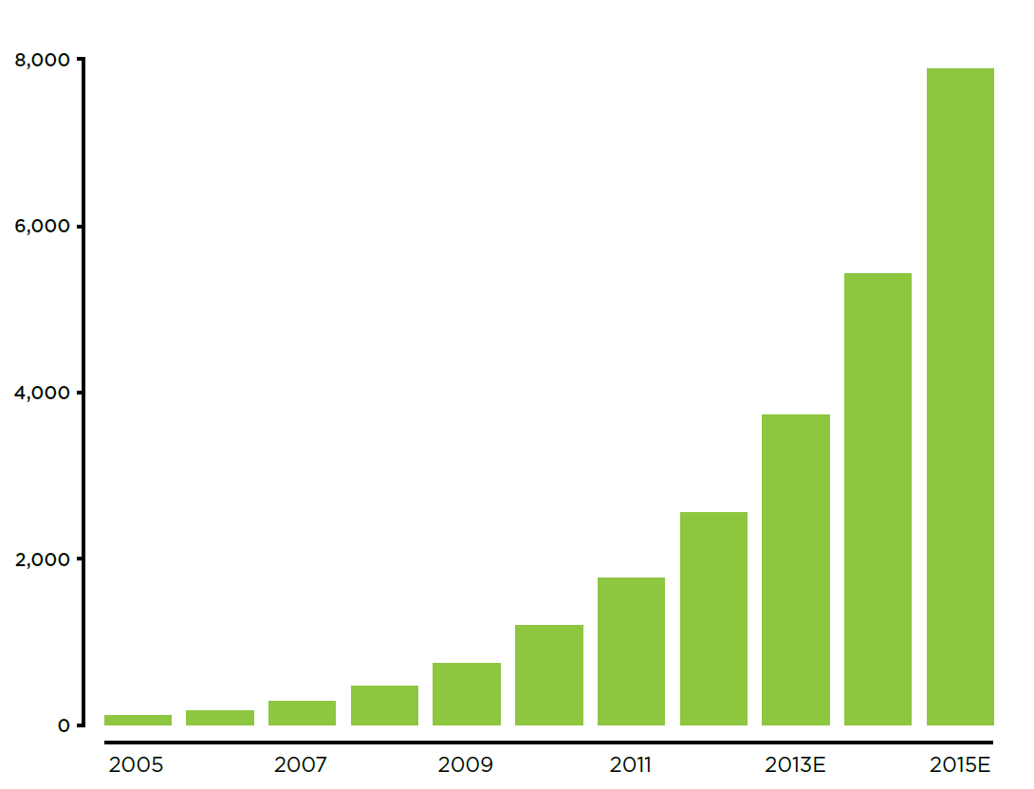
Introduction
Support Vector Machines are powerful but computational complexity increases rapidly as the number of training example increases.
Many Parallel SVM implementations exist, but not their comparative study with any benchmark dataset.
Mostly analyzed for binary classification.
We use the MNIST hand written digit dataset to analyze performance and accuracy of three parallel algorithms.
Notes:
Multi class classification.

Slide 4
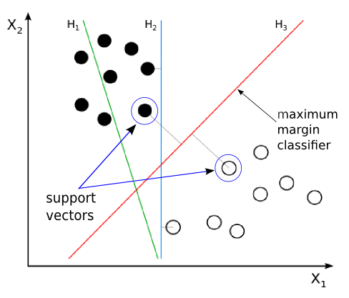
Support Vector Machines

Slide 5
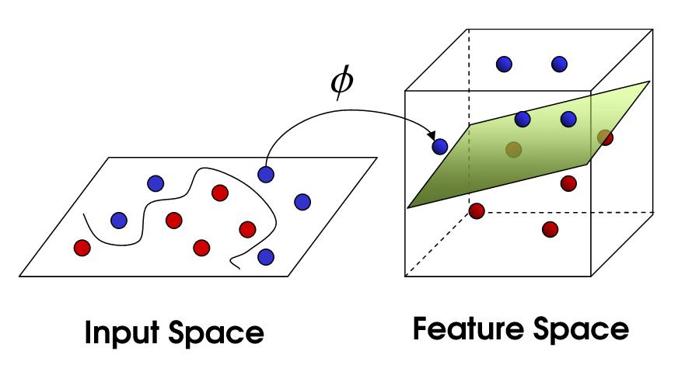
Increased computation : Kernels

Slide 6
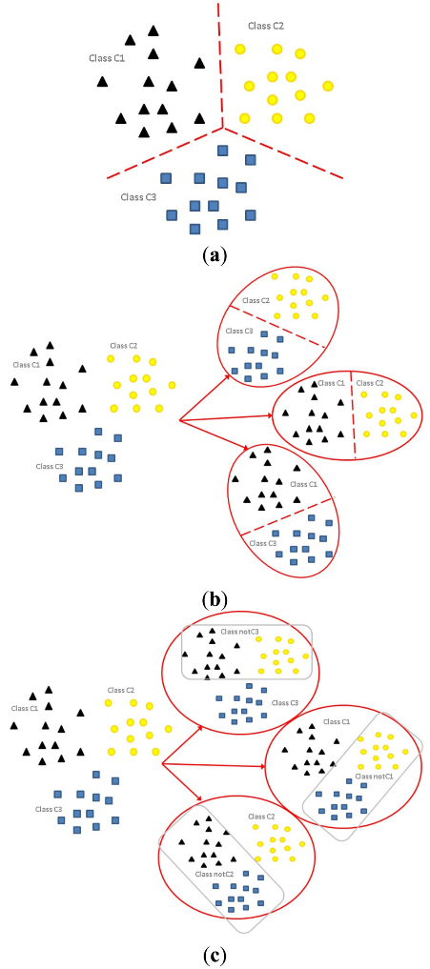
Increased computation : Multi Class Classification
N Binary SVMs

Slide 7
Increased computation : Multi Class Classification
N*(N-1)/2 Binary SVMs

Slide 8
The dataset : MNIST
Mixed National Institute of Standards and Technology database
42,000 data points
28 X 28 pixels

Slide 9
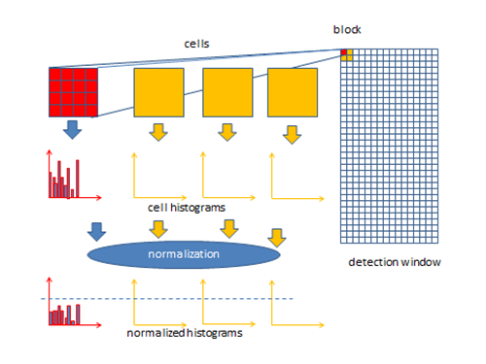
Data Preprocessing : Histogram of Oriented Gradients (HOGs)
Notes:
The dataset where nd how it camr…..

Slide 10
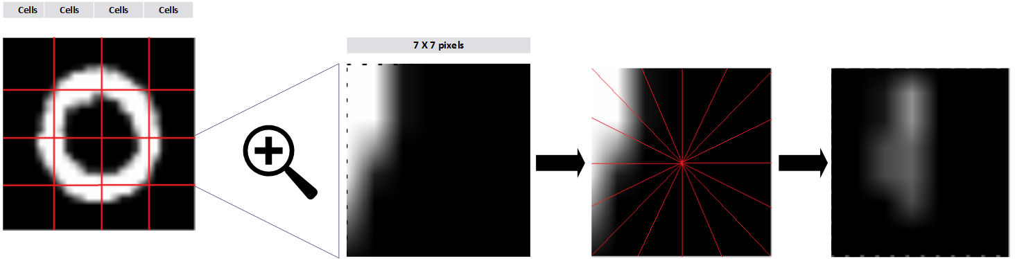
Data Preprocessing : Histogram of oriented gradients
256 features

Slide 11
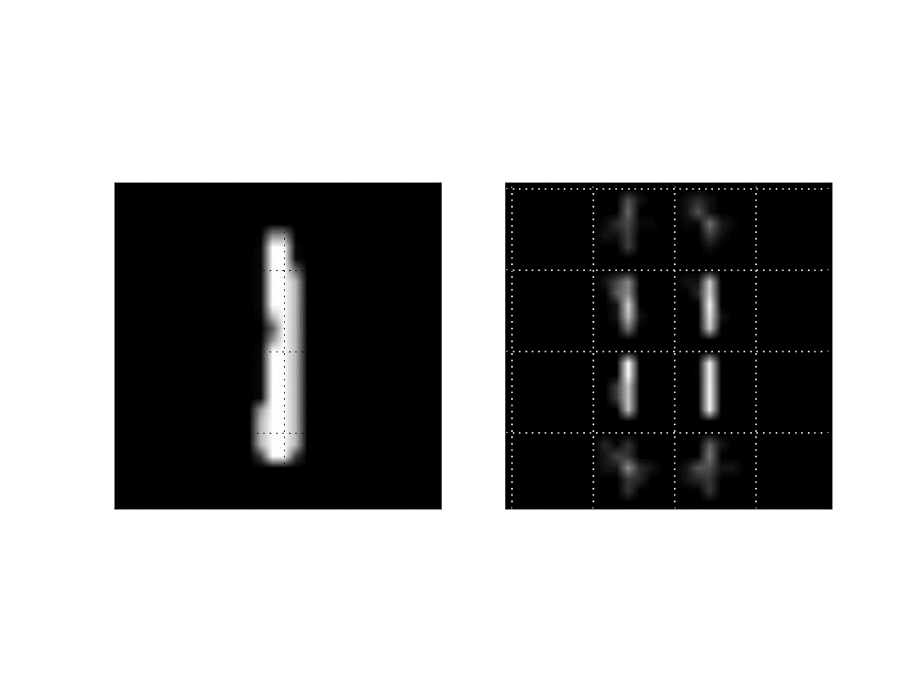
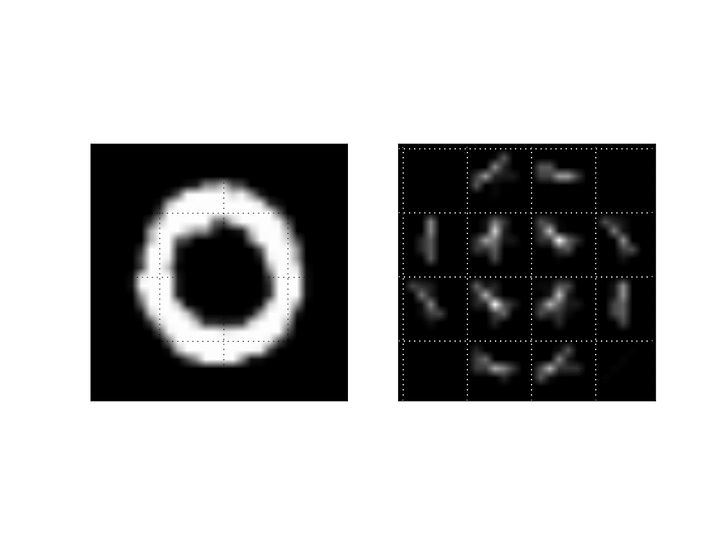
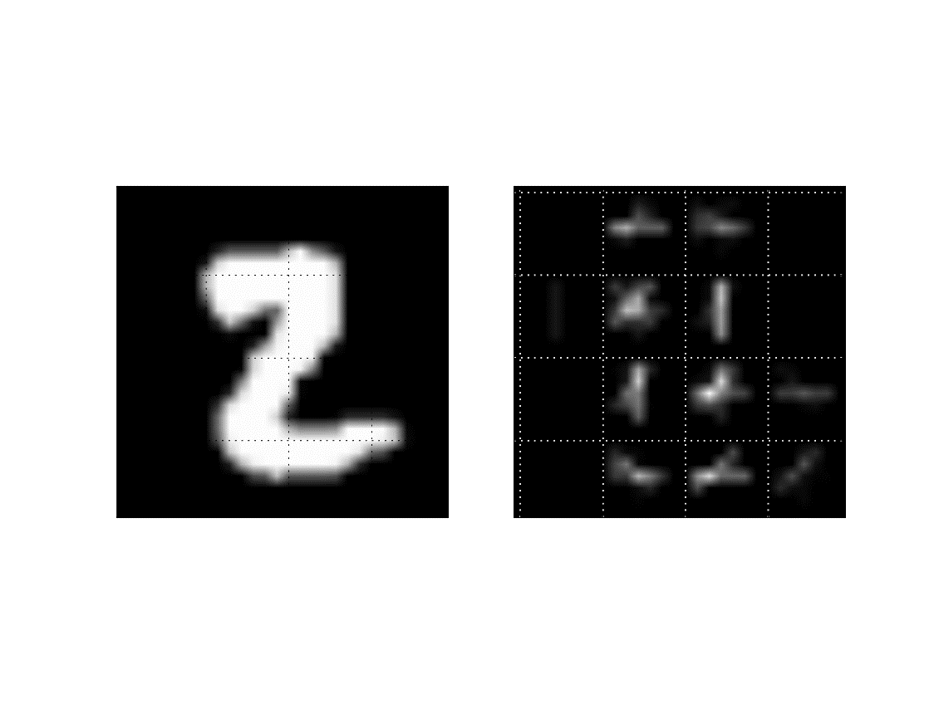
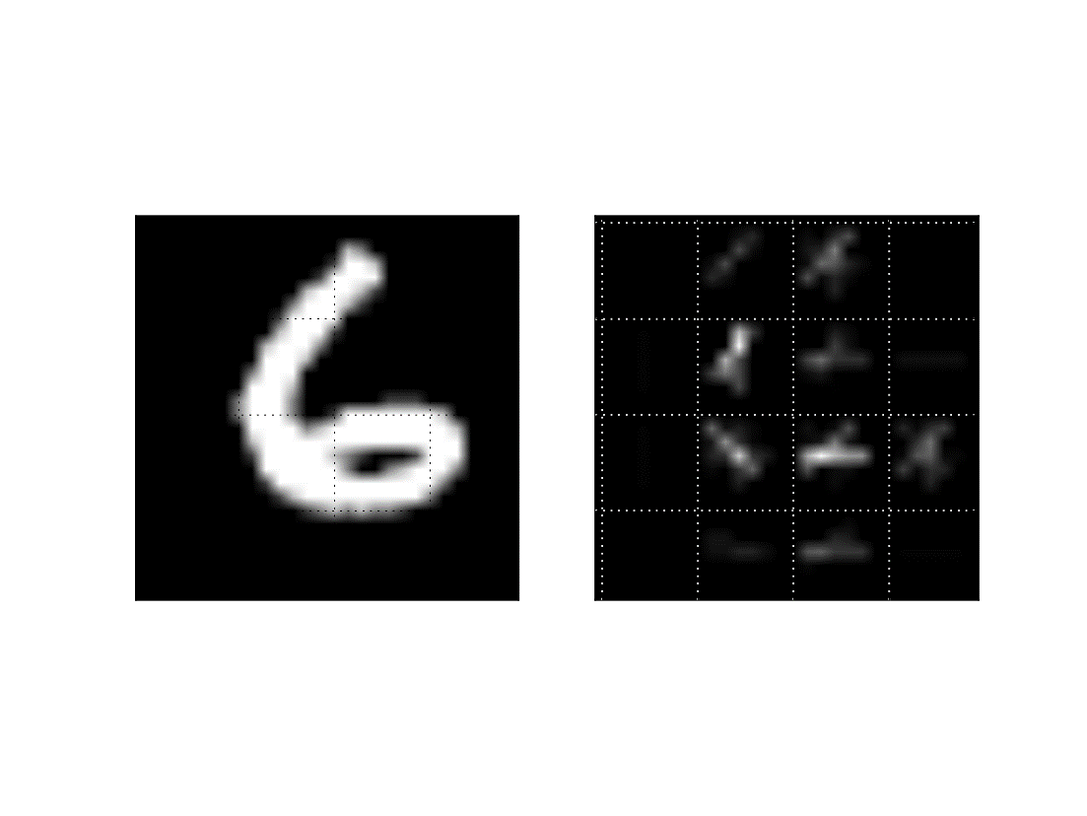
Digits after preprocessing

Slide 12
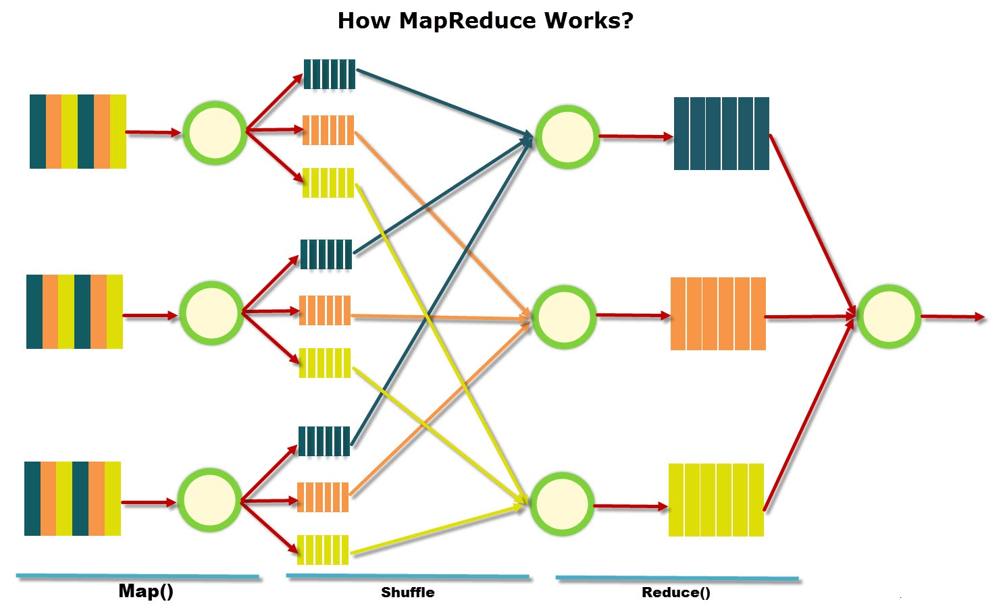
MapReduce Model
Notes:
Key values

Slide 13
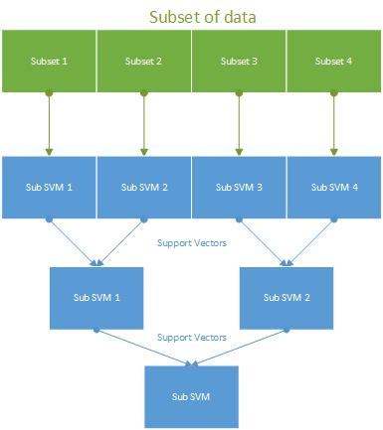
Cascade SVM

Slide 14
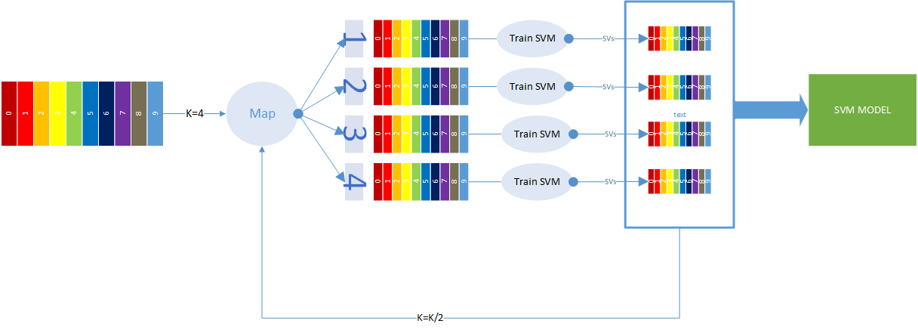
Cascade SVM : MapReduce Implementation

Slide 15
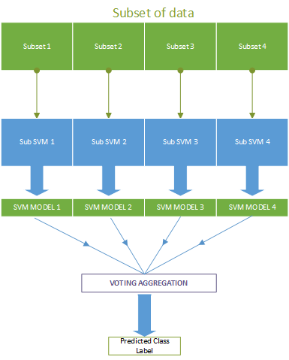
Bagging SVM

Slide 16
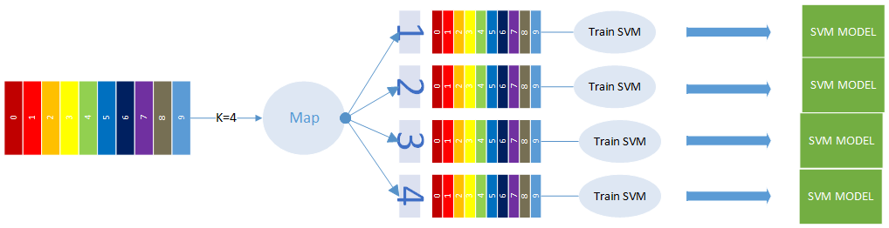
Bagging SVM : MapReduce Implementation

Slide 17
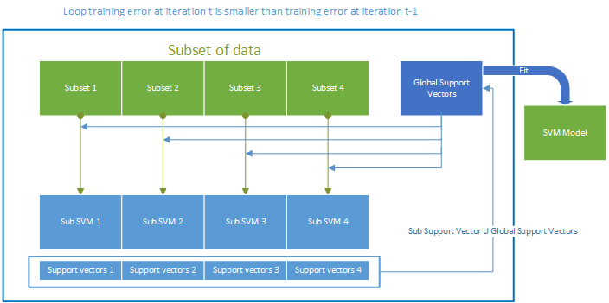
Iterative SVM

Slide 18
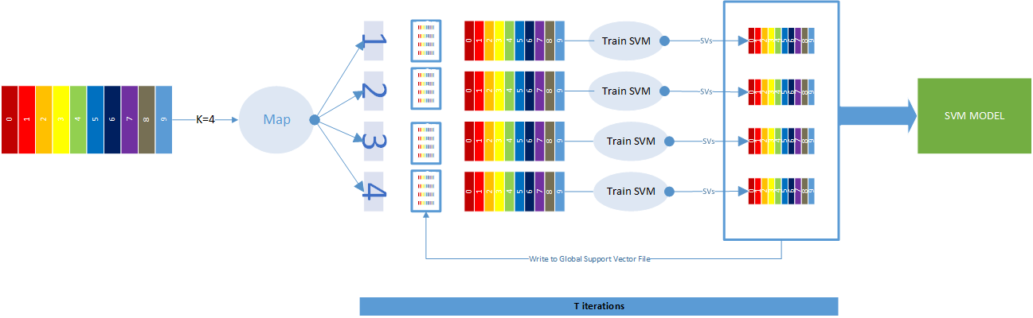
Iterative SVM : MapReduce Implementation

Slide 19
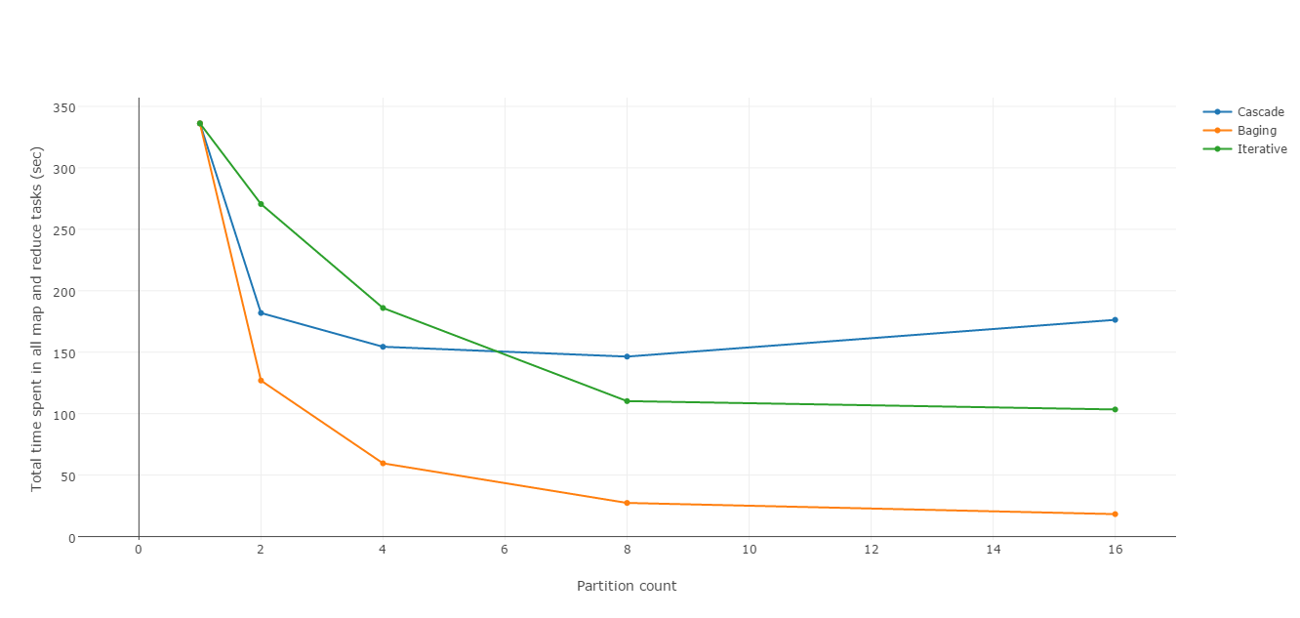
Training time vs Partition count

Slide 20
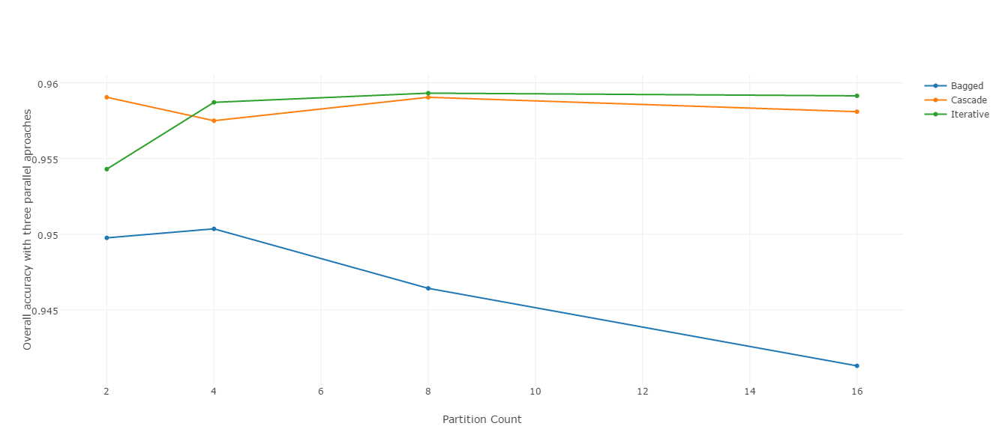
Accuracy

Slide 21
Standard SVM confusion matrix
 | 0 | 1 | 2 | 3 | 4 | 5 | 6 | 7 | 8 | 9
0 | 839 | 2 | 2 | 0 | 0 | 0 | 4 | 0 | 1 | 1
1 | 1 | 882 | 1 | 0 | 2 | 0 | 1 | 4 | 1 | 1
2 | 4 | 4 | 782 | 9 | 4 | 5 | 1 | 2 | 2 | 0
3 | 4 | 0 | 11 | 815 | 1 | 13 | 0 | 3 | 10 | 3
4 | 1 | 1 | 3 | 0 | 825 | 0 | 4 | 4 | 3 | 18
5 | 0 | 0 | 2 | 5 | 1 | 790 | 3 | 0 | 6 | 1
6 | 8 | 1 | 0 | 0 | 2 | 4 | 832 | 0 | 3 | 0
7 | 0 | 6 | 4 | 5 | 7 | 1 | 0 | 815 | 3 | 27
8 | 6 | 8 | 6 | 2 | 0 | 8 | 5 | 1 | 742 | 5
9 | 1 | 2 | 1 | 6 | 15 | 2 | 1 | 17 | 3 | 768

Slide 22
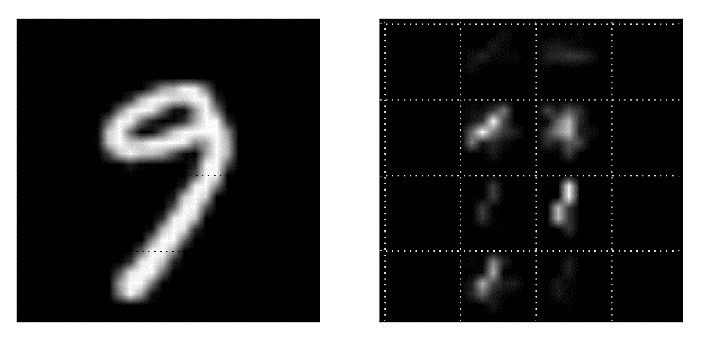

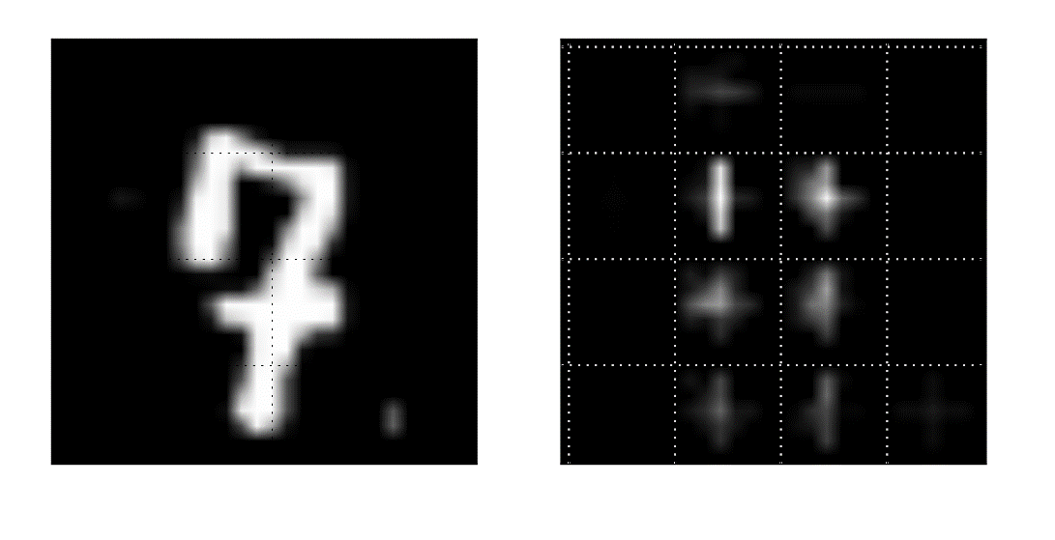
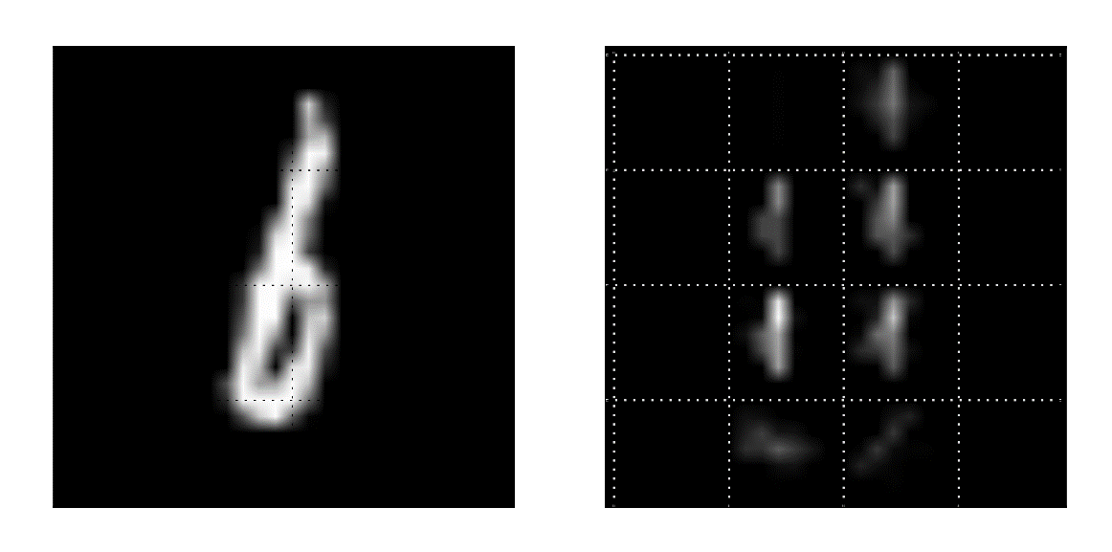
False Negatives

Slide 23
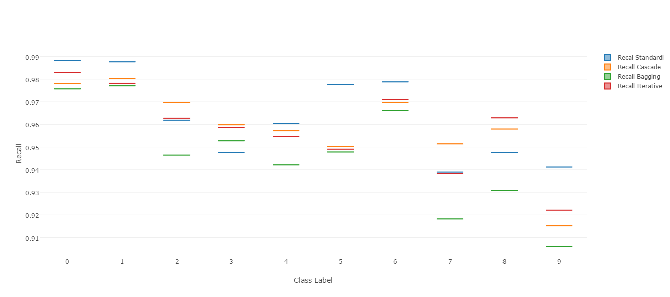
Recall comparison

Slide 24
Support Vectors in the final model
Standard SVM | 6340
 | Cascade | Bagging | Iterative
2 | 6026 | 8137 | 7024
4 | 5941 | 10554 | 7748
8 | 5884 | 13909 | 8522
16 | 5888 | 18143 | 8921

Slide 25
Conclusion
The decrease in accuracy is only 0.5% to 3% for all parallel approaches, making all of them usable.
Iterative SVM is the best choice for high partition counts.
Bagging SVM takes lowest training time, with 3% reduction in accuracy. They can be used for initial approximation on massive datasets.
Cascade SVM gives most relevant support vectors with high accuracy.

Slide 26
Future work
Performance of parallel SVM algorithms on unbalanced data
Quantification of communication cost between mappers and reducers.
More sophisticated method to calculate training error in Iterative SVM

Slide 27
Acknowledgement
Dr. Stan Thomas
Dr. David John and Dr. William Turkett
Dr. Todd Torgersen
Department of Computer Science
Friends and Family

Slide 28
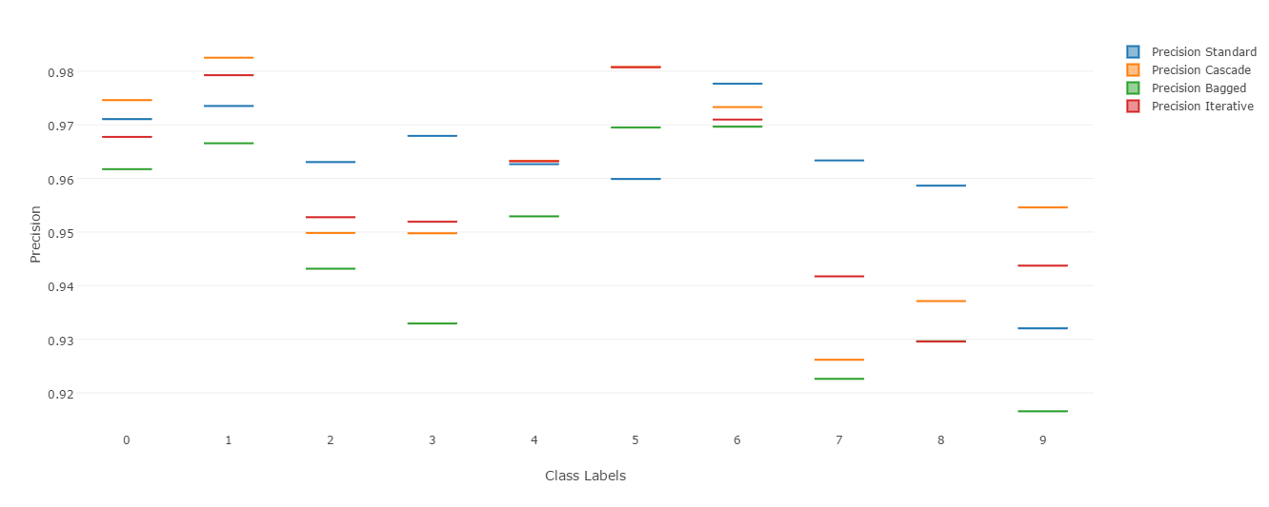
Precision comparison

